Slide 2
Deep Dive: Sharing Innovation
14th December 2023

Slide 3
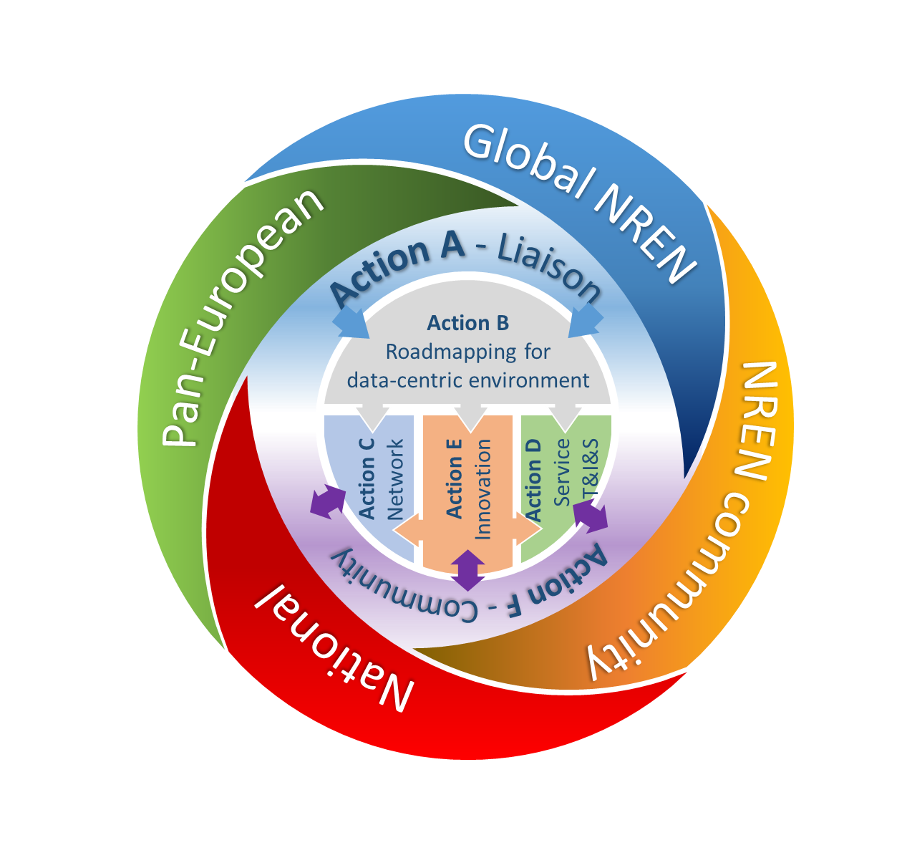
Innovation is at the heart of the GEANT project
in Incubators within WP4, WP5 and WP6
via the Innovation Programme
the newly introduced Development Fund
or less structured as part of the service delivery
or as a result of engagement with various stakeholders
Through the Community Programme TF/SIGs
This session focusses on how we can maximize the innovation potential of the GEANT project:
What ways do we have to bring new ideas into the project?
How do we grow from an idea to a new service?
How do we engage the community, both NRENs and end users, to get their ideas and input, but also to disseminate our work?
Are we missing tools or capabilities that would enable us to innovate even more effectively?

Slide 4
Session Agenda
Lightning Talks
Overview of Innovation Lifecycle - How is it embedded in GN5-1 and GN5-2 – Matthew Scott
GEANT Innovation Programme - Dawn Ng
GEANT Development Fund – Paul Rouse
Thematic Tables - Open Discussion
Table 1: Ideation and Initiation (Donal, Dave)
Table 2: From concept to service (Niels, Tryfon)
Table 3: Outreach and Engagement and Dissemination – NREN and User (Dawn/Maria Isabel)
Table 4: Tools and Capabilities (Piotr, Jenni)
[pick your table - change half way through]
Notes: https://docs.google.com/document/d/1TcG3wkOAeiiSoScWn081N41rnRgyhooxSqBR0HnMLts/edit?usp=sharing

Slide 5
Table 1 - Ideation and Initiation (Donal, Dave)
Idea generation/ Input/ Proposal/Concept creation – how is this happening now?
Do we have enough ideas?
Where do ideas usually come from? Push or pull?
How is the quality of the ideas?
Turn ideas into good proposals?
How can we enable cross-divisional work?

Slide 6
Table 2: From concept to service (Niels, Tryfon)
At what stage in the process is the most support needed from us?
Does the current innovation to service pipeline work for us?
Do we have gaps?

Slide 7
Table 3: Outreach and Engagement and Dissemination – NREN and User (Dawn/ Maria Isabel)
Which channels are we currently using? Which are working well, where are gaps?
Which roles in the NREN are most beneficial for us to engage with?
What are successful Innovation models in NRENs?
How can we build on and promote our successes?
How can we involve large user groups? i.e. services for ESFRi, ESA etc]

Slide 8
Table 4: Tools and Capabilities (Piotr, Jenni)
Do we have the right tools and capabilities to support ideas?
How can we lower the barrier to entry?
How can we secure successful conclusion? Is our current approach effective and efficient?
Should we provide a project central Decision tree / clearing point – which programme for whom?

Slide 9
Thank you
Any questions

