Slide 1
GÉANT Automation Platform - GAP
13 December 2023
Simone Spinelli
WP7-T1

Slide 2
WHY ARE WE HERE (TALKING ABOUT AUTOMATION)?
ME:
I am very excited to tell you about our progress
I am looking forward to talk to you after this presentation
YOU:
You want to know more about Automation & Orchestration, or you want to check where we are
You think Automation & Orchestration do not apply to you or maybe you don’t have time for that
You want to know more about the migration of the GÉANT Network
You also want to talk about what we can collectively do about Automation & Orchestration
BOTH:
We are somehow part of GEANT: a community!

Slide 3
AUTOMATION vs ORCHESTRATION
Needs:
Change of vendor:
Copy&paste is not an option
Lift&shift is not an option (No translation)
Hybrid period during migration
Speed/Scale
Consistency/Predictability
Service oriented logic
Converge to something that we can collectively support&maintain
Orchestration:
Represent the business logic
Involves multiple systems
Agnostic to the local context
Automation:
Atomic changes: compile a template, do something
Context specific (Nokia/Juniper/Infoblox)

Slide 4
MIGRATING TO A NEW VENDOR
New platform is NOKIA 7750SR-S:
No previous experience with SROS: but it is really close to JunOS – with Caveats
Relatively small community: but Netconf works as expected
Brings 400/800G to the edge: a big step towards Terabit network
Introduces ZR+ optics
Sites organized by TIERS:
One ring at the time
Going from the core to the edge and then back
Migration will be in 2 phases:
PHASE1: Nokia nodes deployed as LSR (starts Q1 2024)
PHASE2: Nokia nodes promoted to PE (starts Q3 2024)
Totally automated:
Operators run workflows
No CLI needed in sunny days

Slide 5
GAP – MAIN COMPONENTS
Workflow Orchestrator
Generic, all-purpose orchestrator
Written in python
Pydantic as data-model engine
Takes care of the high-level mechanics
Developed by SURF and ESNet (and now supported by GÉANT)
Ansible
Generic automation-engine
Supported - in some forms - by most of the network brands
Easy to use, but needs some adjustments
LSO – Lightweight Service Orchestrator
Gives APIs to call ansible
Simple, genric, does nothing
Developed by GÉANT, available on gitlab

Slide 6
GAP – HIGH LEVEL DESIGN

Slide 7
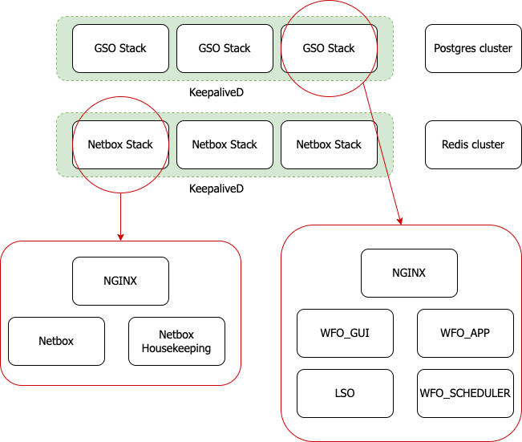
GAP – Infrastructure
Deployed with… Ansible ☺
Everything is shipped as a container:
Minimal req on hosts
Dependencies are self-contained
Strict DTAP process:
Managing Releases is more complicated than we though initially
Same goes for general packaging and versioning
Big help from SWD
High availability is more important than performances (for now)

Slide 8
GÉANT MIGRATION – PHASE 1
Initial deployment
Boot-config to make the router avaialable via OOB
Targeted by GAP to deploy base config
Insertion in the network
First trunk to Juniper: IGP + Multicast feed
Insertion in tools: router is ready for service
Migration of IPtrunks
Router starts carrying traffic
Users and services stay on Juniper

Slide 9
GÉANT MIGRATION – PHASE 1 – MODELS
Mapping between Products/ProductBlocks and Ansible roles
Special roles for migration
Hierarchy is important to avoid data replication
Hierarchy is important to describe the network
Hierarchy is important. Really
* Not all the attributes are shown

Slide 10
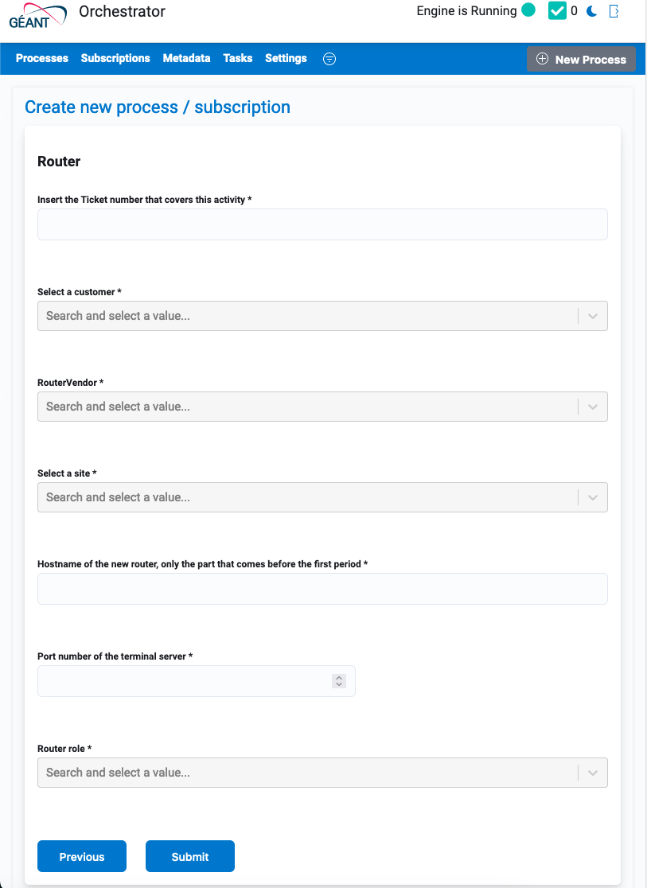
GÉANT MIGRATION – PHASE 1 – ROUTER_CREATE WORKFLOW

Slide 11
GÉANT MIGRATION – PHASE 1 – Other workflows
For all subscriptions
Creation/Modification/Deletion
Verification workflow still WiP
For Iptrunks
ISIS metric modification is separated
Migration is different from modification
For Routers
Insertion in iBGP mesh
Insertion in Tools after deployment
Lessons learned:
Decomposition is very important to keep config objects disjointed
This is not always possible, so fixes are needed during verification workflows
A good model facilitates these processes, but we needed few interations to get here
Mapping Ansible roles to specific workflows/subscriptions also helped

Slide 12
GÉANT MIGRATION – PHASE 2
Migrating one or more circuit at the time:
All services insisting on the circuit are migrated together
All the OSS/BSS systems are updated after migration
Basic checks are run automatically
Rollback possible until the end of the process
Config gets deactivated on the source until services are fully migrated
Services on the new platform are functionally equivalent:
Lots of cleanup
Customizations will be revised periodically

Slide 13
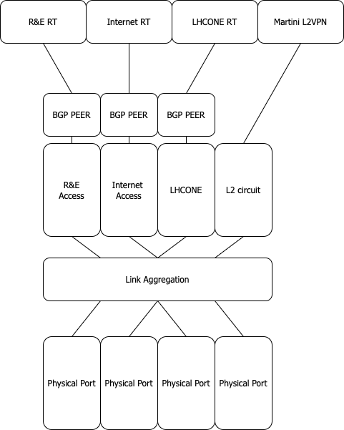
GÉANT MIGRATION – PHASE 2 – MODELS & WORKFLOWS
Modeling for phase2 is going to be more complicated (many Products)
We aim for productBlocks that can be reused
Correct stitching between physical and logical layer is fundamental: Many services -> One port
Migration workflows should be able to identify the logical dependency and migrate all the services insisting on the port
Verification workflows should be straightforward, but there maybe points of contact between services.
Additional plugins for OSS/BSS will be needed:
Kentik
Other internal tooling
A very important chance to rationalize and give more structure to our offer

Slide 14
GAP – CREDITS & REFERENCES
This work has been done collaborating with many different organizations, so we want to say thanks!
SURF and ESNet: for the onboarding and all the hints!
i2CAT/GRNET/CARNET/and others: for all your help in making this (almost) ready
People in the GOAT team (GÉANT) - You can write us at goat@geant.org:
Karel
Aleks
Mohammad
Neda
… They are all here, come and talk to us! ☺
You can find all the code here: https://gitlab.software.geant.org/goat/gap
More info about Workflow Orchestrator: https://workfloworchestrator.org/
More organizations are becoming interested in this, feel free to stop me and ask questions, and stay tuned for TNC24!

Slide 15
Thank you
Any questions

